Slide 1

Trees
http://www.cs.middlebury.edu/~candrews/classes/genart/assignment12.html

Slide 2
Hierarchical Structures
some information cannot be easily modeled using a list
it is frequently convenient to organize information in a hierarchy
for example, the directory structure on a disk is organized in a hierarchical format
Trees

Slide 3
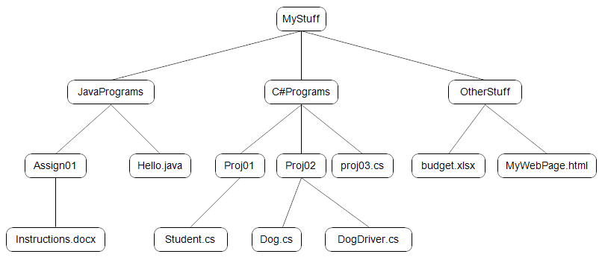
Directory Structure
Trees

Slide 4
Trees
a structure of this type is called a tree
tree structures enable very efficient searching
for this reason, trees are frequently used for storage of data in large databases
trees are used in compilers – for example, to check the syntax of a program
Trees

Slide 5
Terminology
the single node at the top of the tree structure is called the root of the tree
nodes that have no offshoots are called leaves
a node directly above a second node is called a parent node; the second node is the child of the parent node
Trees

Slide 6
Terminology
nodes with same parent are siblings
the terms descendent and ancestor are also used to express relationships
Trees

Slide 7
Example
root
C#Programs and OtherStuff are siblings
parent of Assign01
example of leaves
children of OtherStuff
Trees

Slide 8
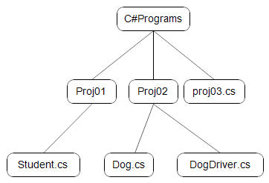
Subtrees
a node and all of its descendants is called a subtree
subtree of tree on previous slide
Trees

Slide 9
Height of a Tree
root node is level 0
children of root node are at level 1
children of level 1 nodes are at level 2
…and so forth…
the height of a tree is the maximum level of any node
Trees

Slide 10
Example
level 0
level 1
level 2
level 3
a tree of height 3
Trees

Slide 11
Binary Trees
in a binary tree, each node has at most 2 children
in our examples of binary trees we use integer values
these might represent key values of records stored in a database that we wish to search
Trees

Slide 12
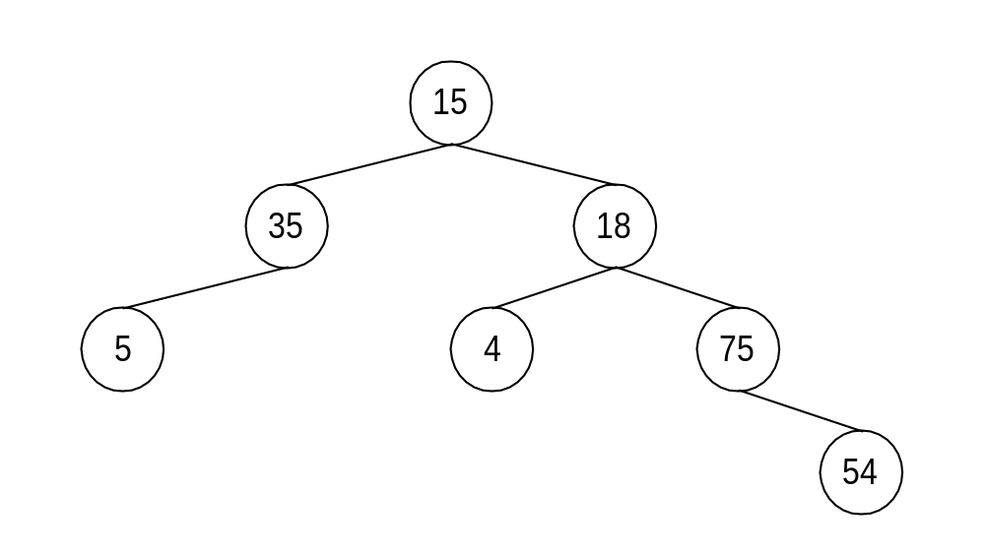
Example
Trees

Slide 13
Right and Left Children
in a binary tree, the children of a node are referred to as the left child or the right child
Trees

Slide 14
Example
right children
left children
Trees

Slide 15
Binary Search Tree (BST)
a binary search tree (BST) is a binary tree with the following properties:
  no two nodes contain same data value
  relations “less than” and “greater than” are defined for the data type stored in the nodes – that is, nodes are comparable
  for each node in the tree, the value stored in the node is less than any value stored in its right subtree and greater than any value stored in its left subtree
Trees

Slide 16
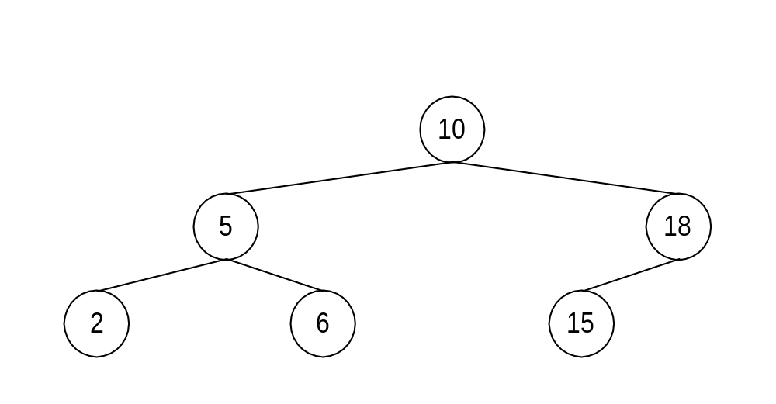
Example
Trees

Slide 17
Searching in a BST
to search for 6 in the tree given above:
  start at the root
  6 < 10, so move left
  6 > 5, so move right
  6 == 6, so FOUND! after three probes
Trees

Slide 18
Searching in a BST
to search for 20 in the tree given above
  start at the root
  20 > 10, so move to the right
  20 > 18, so move to the right
  we look for the right child of 18 and discover 18 has no right child (i.e., it is null), so NOT FOUND after three probes
Trees

Slide 19
Inserting Values
suppose we want to insert the following values into an initially empty binary search tree
the first value listed is the root value
18 > 10, so it becomes the right child of the root node
10, 18, 5, 6, 2, 15
Trees

Slide 20
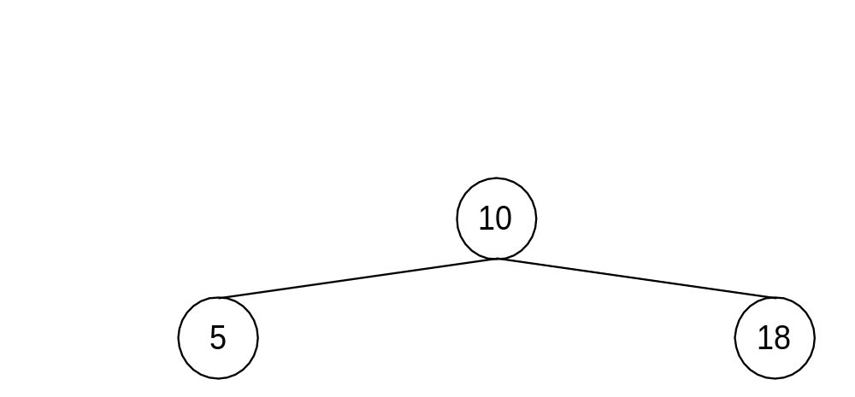
Inserting Values (Continued)
5 < 10 so it becomes the left child of the root node
10, 18, 5, 6, 2, 15
Trees

Slide 21
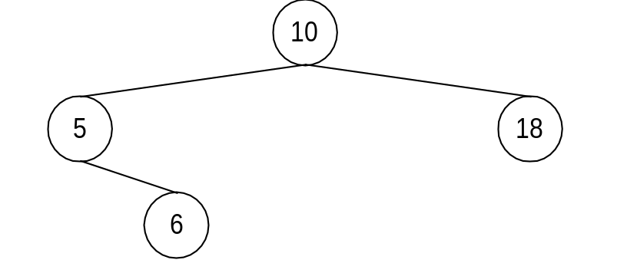
Inserting Values (Continued)
6 is < 10, so we inspect the left child of 10, which is 5
6 > 5, so 6 becomes the right child of 5
10, 18, 5, 6, 2, 15
Trees

Slide 22
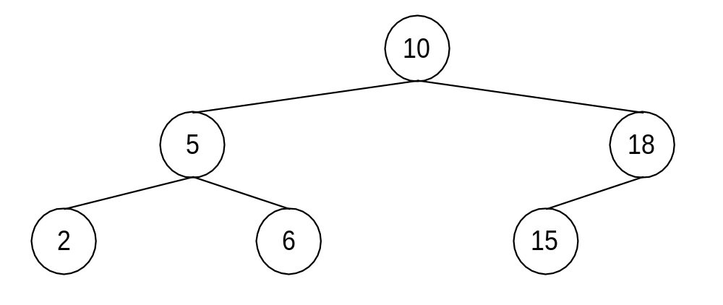
Inserting Values (Continued)
continuing in this fashion, we finally end up with this tree
10, 18, 5, 6, 2, 15
Trees

Slide 23
The Order of Insertion Matters!
suppose we insert the same values into a binary tree, but in this order
we will end up with a tree that is quite different from the original
  2, 5, 6, 10, 15, 18
Trees

Slide 24
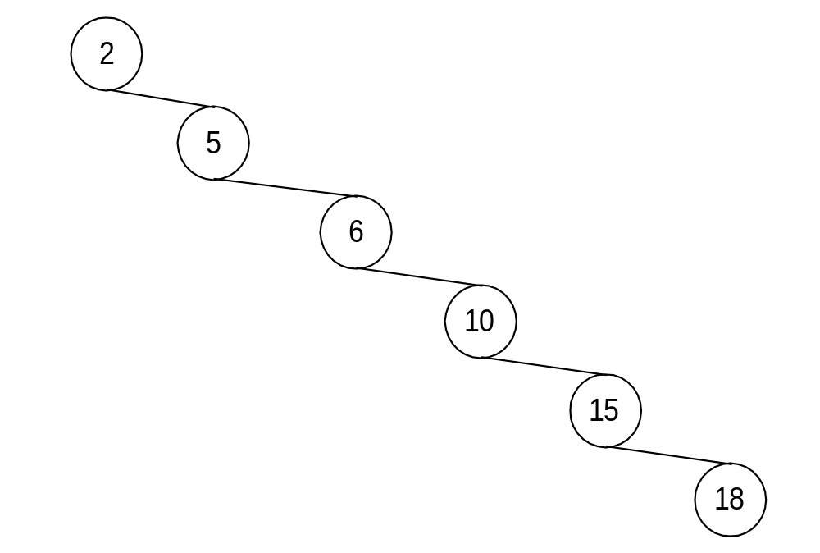
Insertion Results
this type of tree is called a chain
  2, 5, 6, 10, 15, 18
Trees

Slide 25
Trees
The End

